Slide 1
Tasks of an advisory teacher and presentation of an intelligence test

Slide 2
The advisory teacher provide advice to students, parents and to colleagues, if there are questions and problems in school issues
Problems in learning and understanding
Difficulties in social behavior
Questions about the Bavarian school system
Questions about the school career
Questions about the start with school (school enrolment)

Slide 3
Presentation of the HAWIK -IV
- Usually this test lasts about 90 minutes
- It consists of 10 different tasks
- The test results give informations about
the linguistic comprehension
the ability to reason
the working memory
the processing power (to deal with tasks and questions in a certain speed)

Slide 4
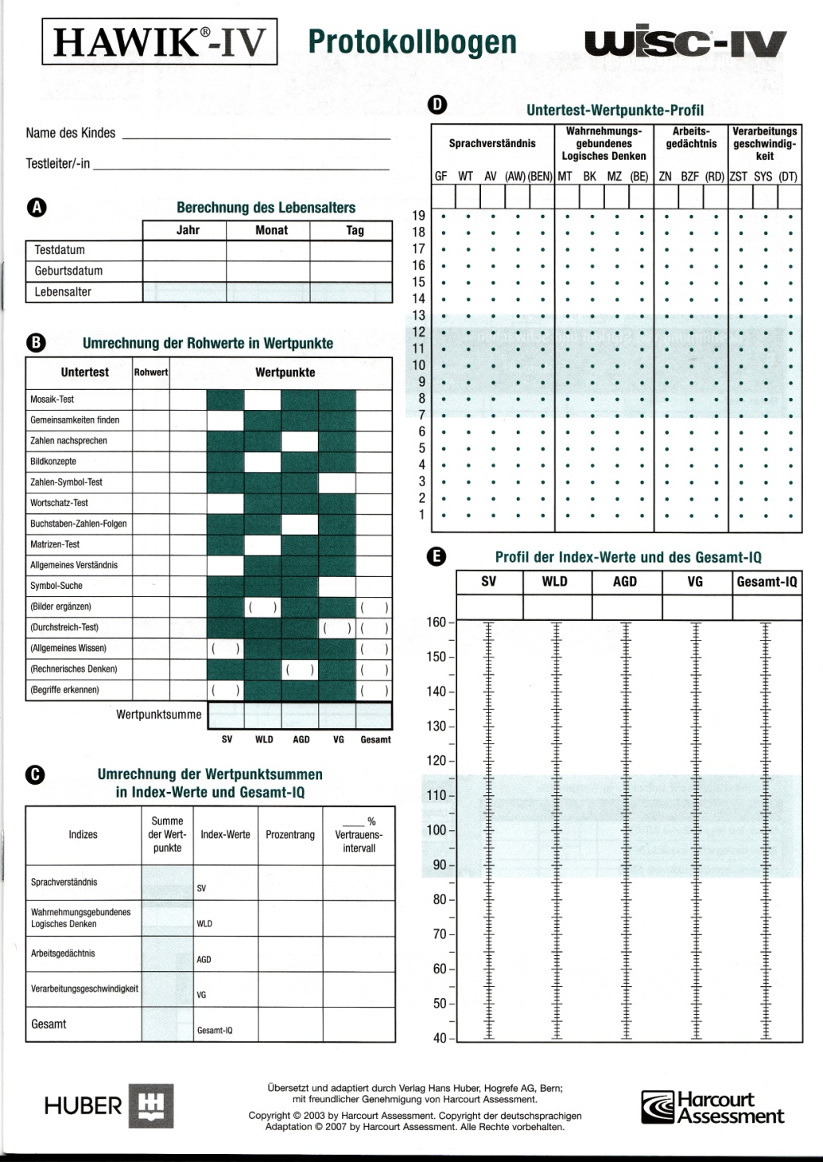

Slide 5
