Slide 1
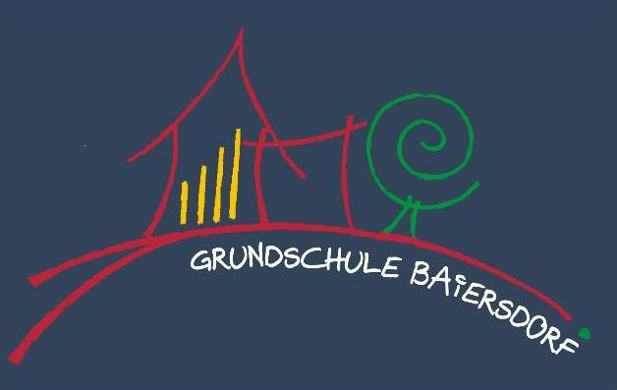
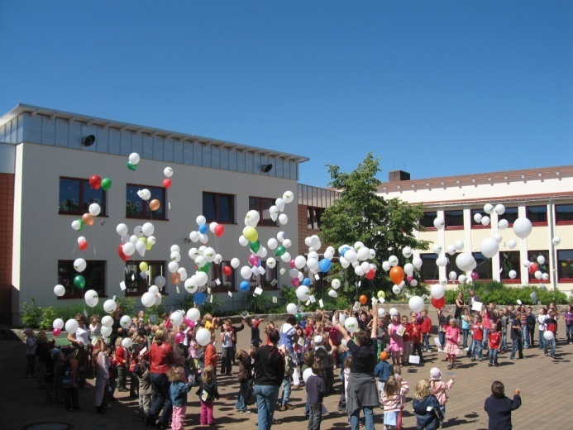
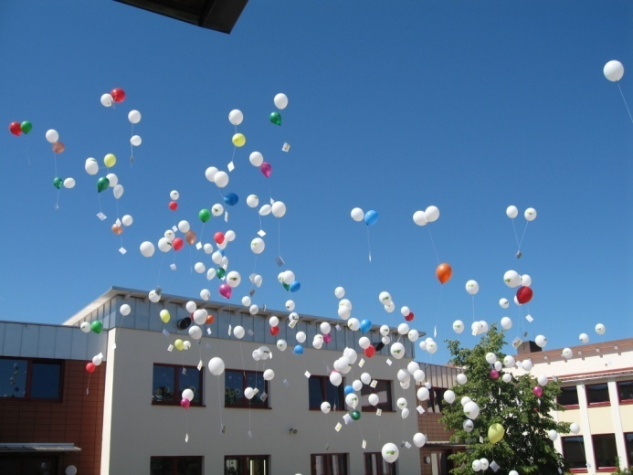
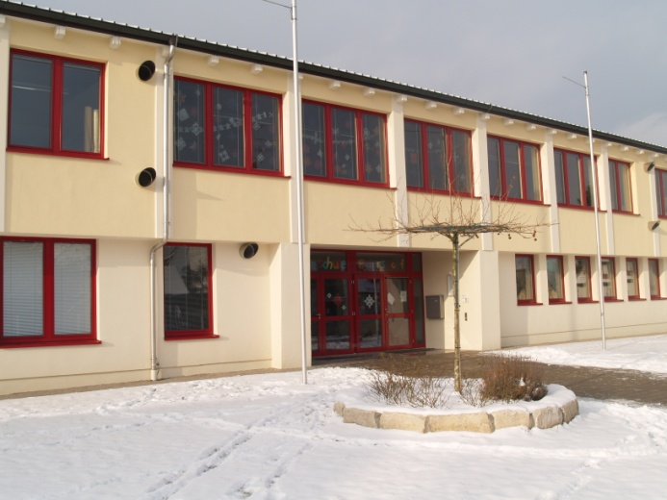
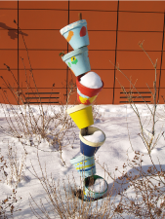
Grundschule Baiersdorf

Slide 2
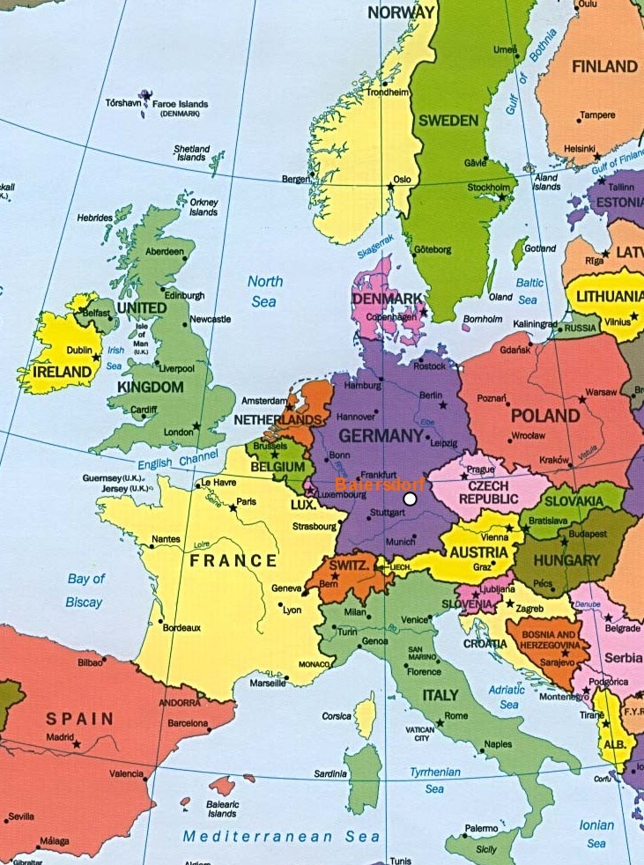
Grundschule Baiersdorf

Slide 3
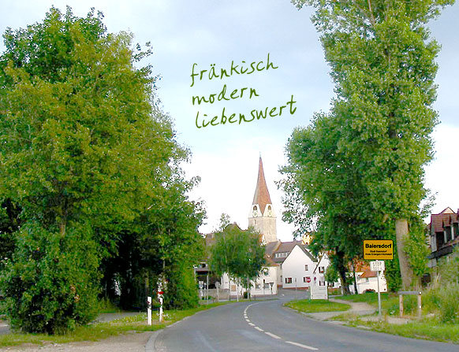
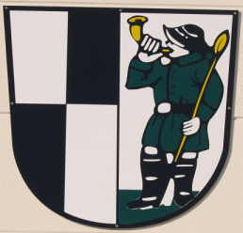
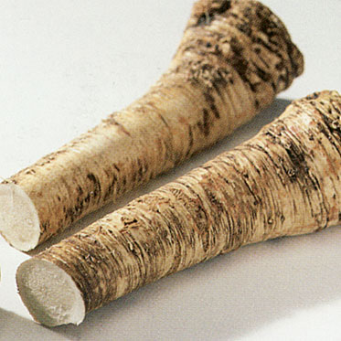
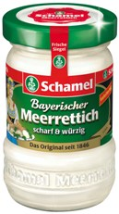

Baiersdorf
7.700 inhabitants
City of the horseradish
„Grundschule“ primary school, 310 pupils, 6-10 years
„Hauptschule“ secondary school, 280 pupils, 10-16 years

Slide 4
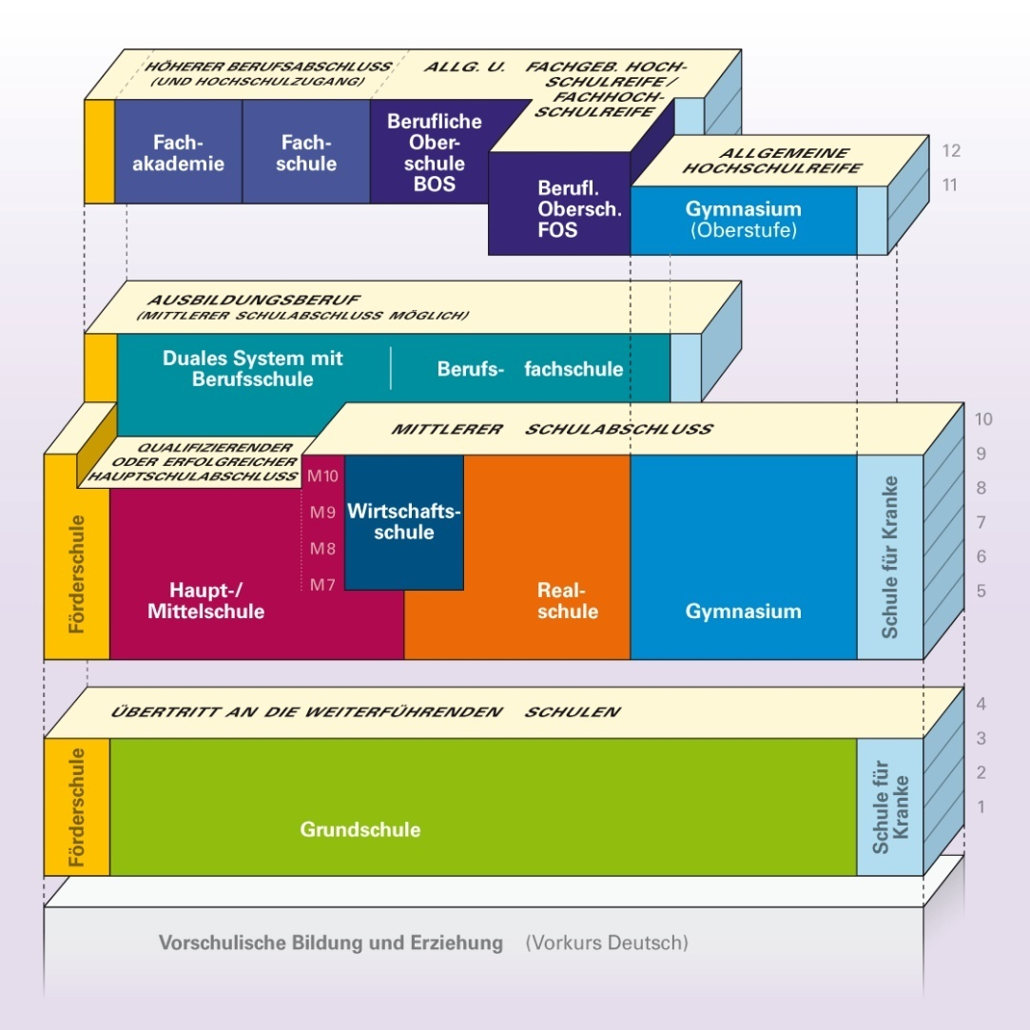
Bavarian school system
Quelle: www.schulberatung.bayern.de

Slide 5
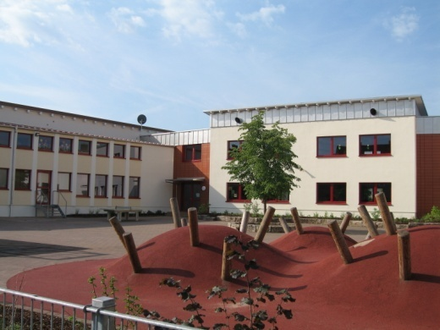
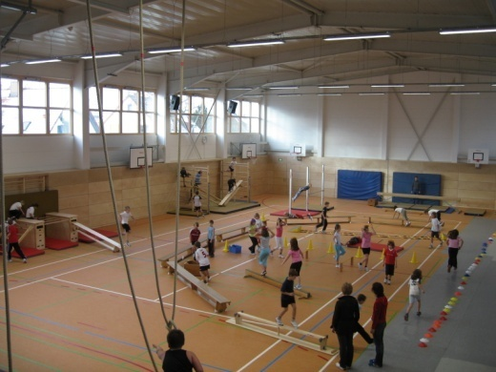
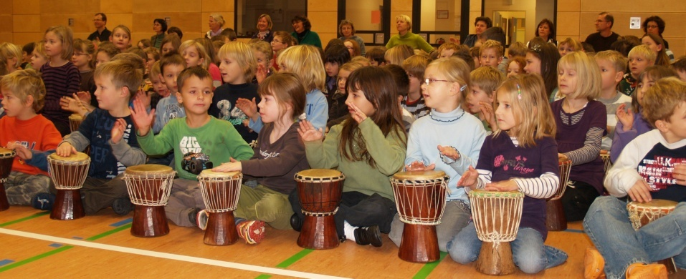
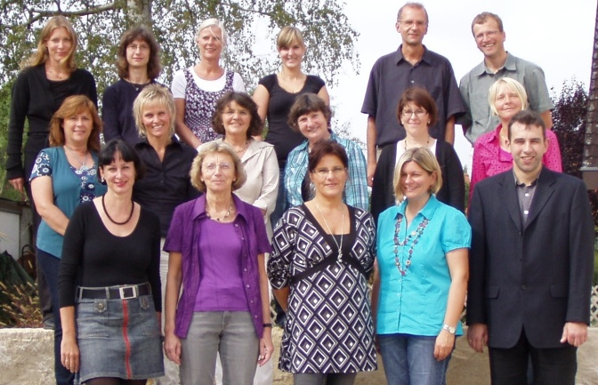
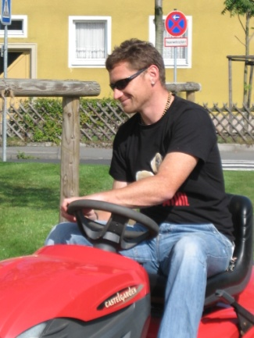
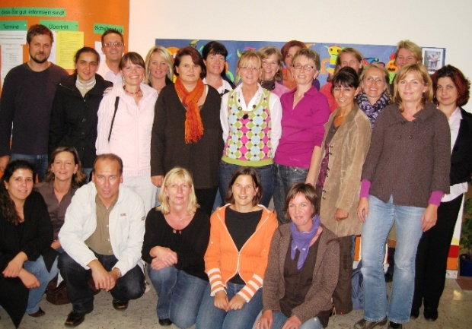
Our school
School building (1959): renovated 2005-2007
sports hall: rebuilt 2008
310 pupils from 6 to 10 years in 12 classes
22 teachers (most of them working part time)
The concierge (most important man of the school)
The parents‘ association (2 parents of every class)

Slide 6
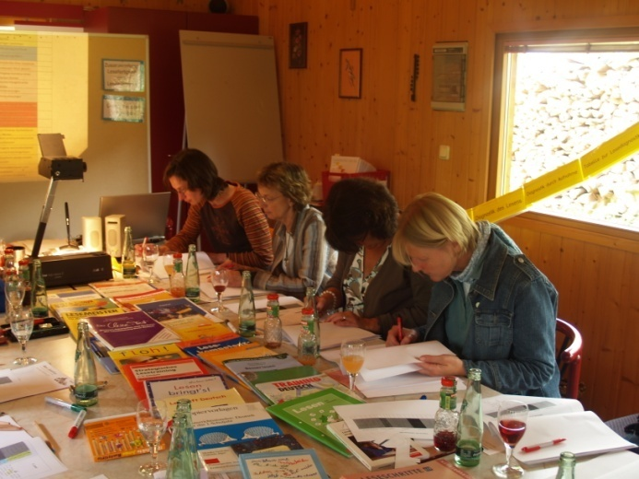
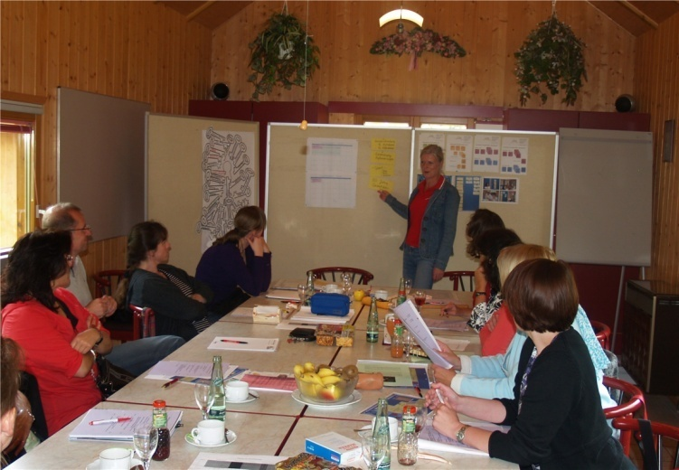
impressions of the teachers‘ work
Weekend convention in may 2009
to set and evaluate objectives
to discuss the key aspects and main events of the next year
to support the team building process

Slide 7
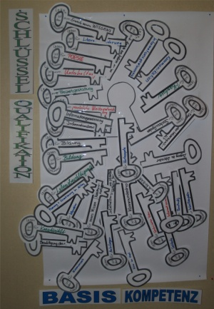
key aspects of activity
2007 - objectives for social education
2008 - code of behaviour in our school - special training courses to advance pupils‘ capacity in litaracy
2009 - special training courses to advance pupils‘ capacity in litaracy and maths
2010 - the use of knowledge-tests to build special training courses

Slide 8
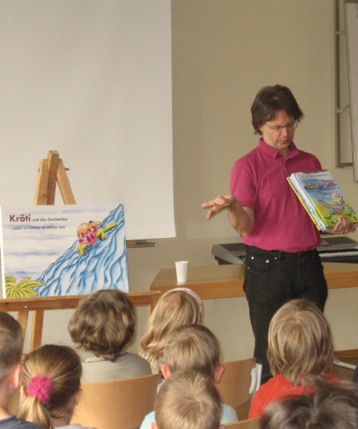
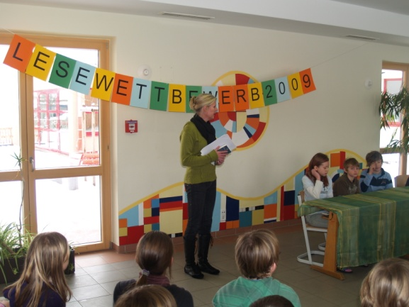
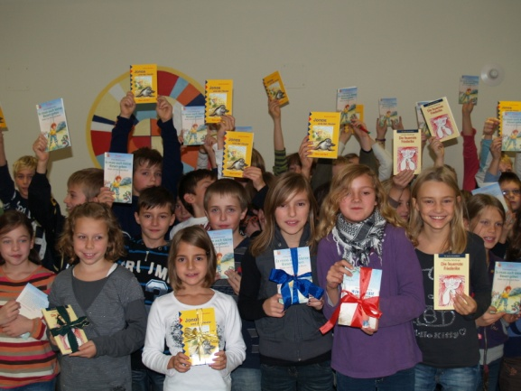
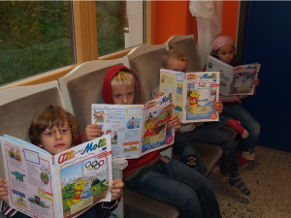
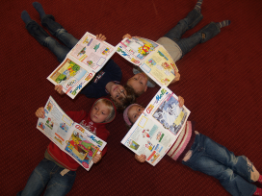
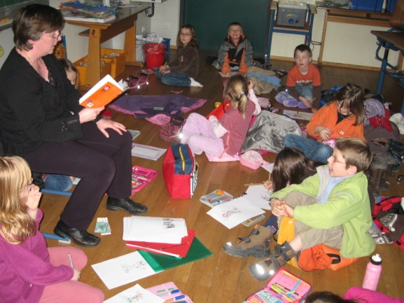
literacy activities
a children‘s book writer at school (23rd of april
= day of the book)
Literacy competition
new story books for the classroom work
parents are reading to pupils
The „room of silence“

Slide 9
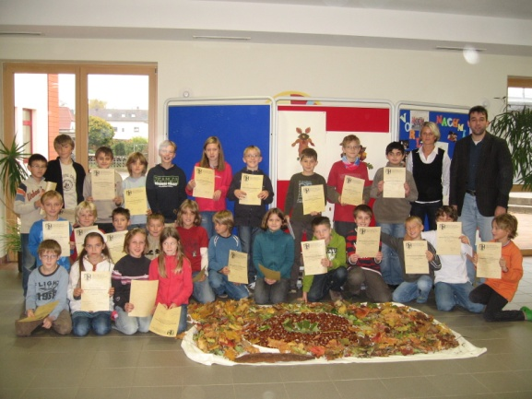
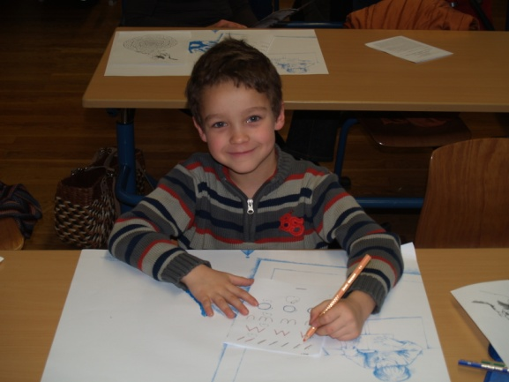
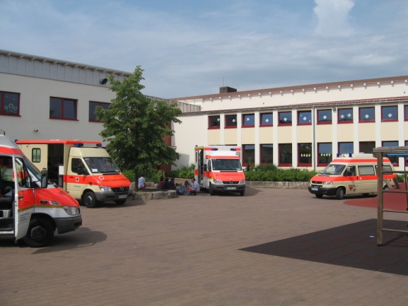
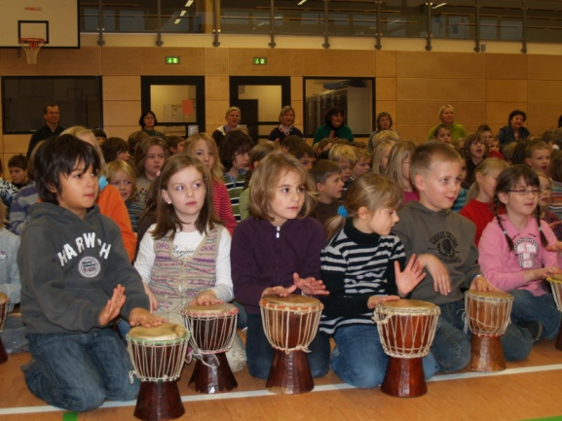
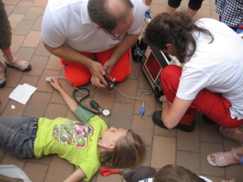
special activities in 2009
competition in maths
for pupils of 4th grade
special course for sinistrals and their parents
first-aid course for pupils of 3rd grade
drumming workshop

Slide 10
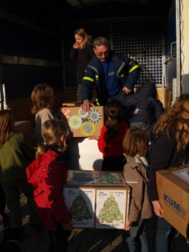
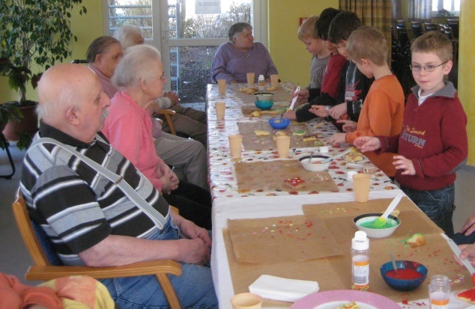
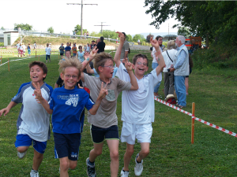
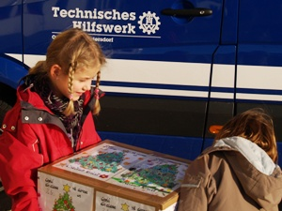
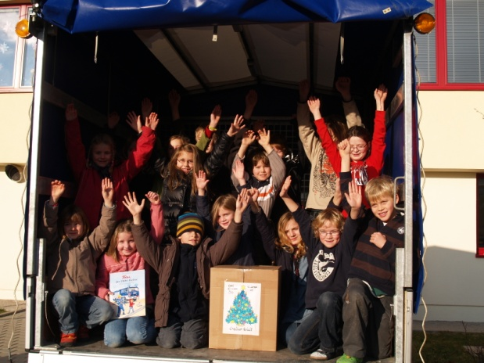
social projects
pupils are baking biscuits at the old peole‘s home
„miles for africa“: pupils collected 10.000€
for a hospital
in Burkina Faso
Christmas parcels for children in eastern europe

Slide 11
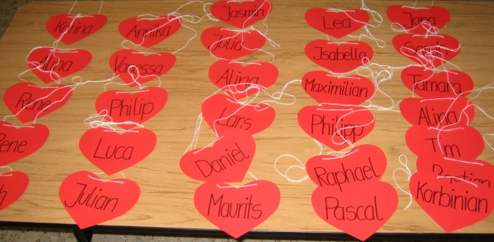
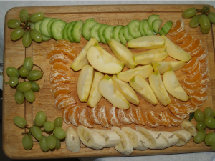
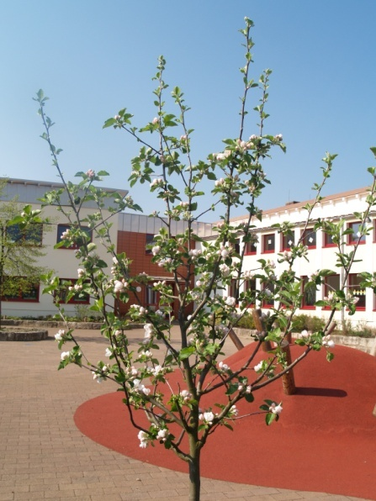
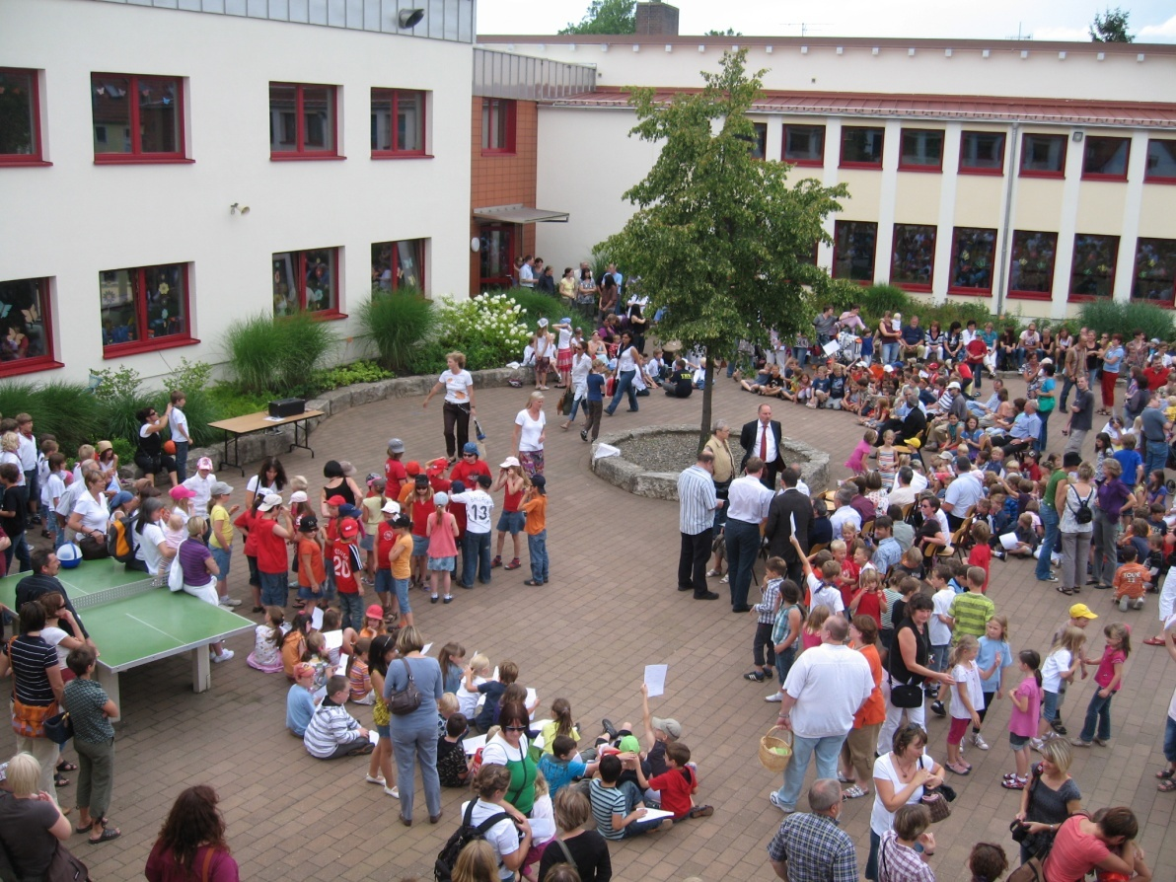
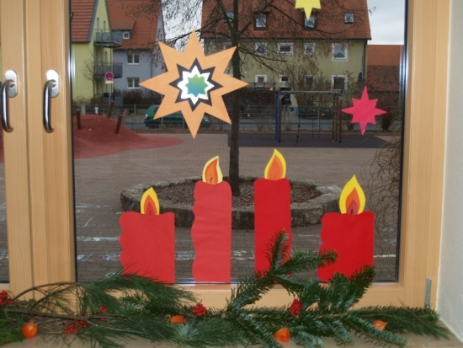
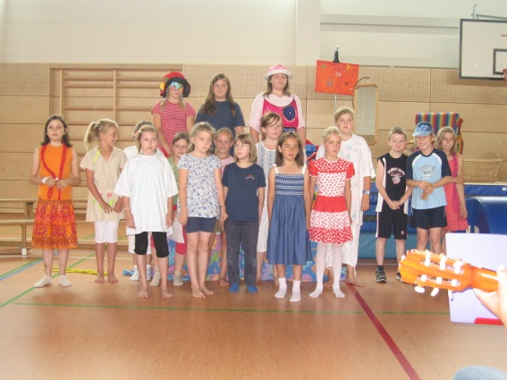
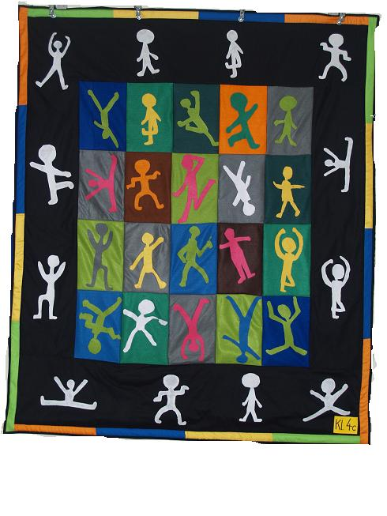
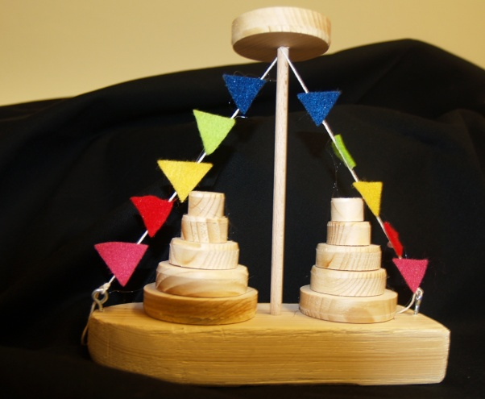

Slide 12
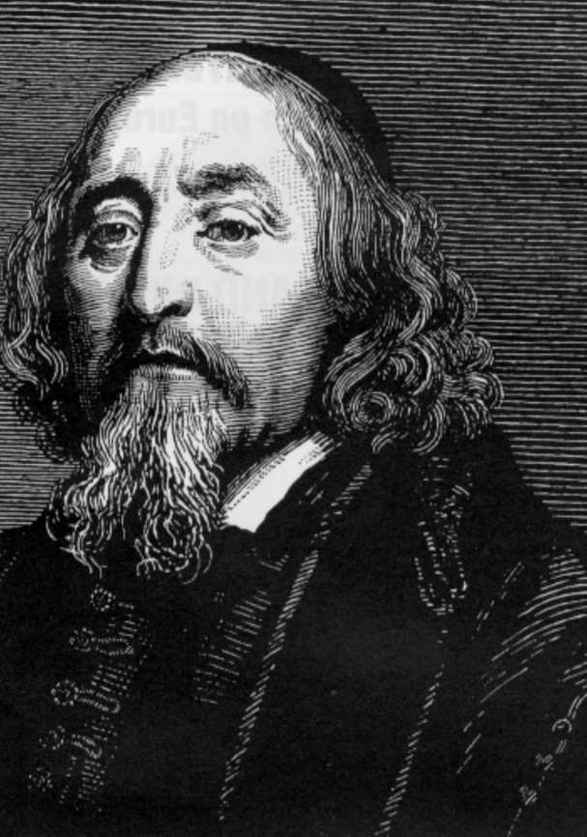
Johann Amos Comenius, we are prepared!

